Slide 1

PowerPoint Slides
Computer Organisation and Architecture
Smruti Ranjan Sarangi, IIT Delhi
Chapter 1 Introduction to Computer
Architecture
PROPRIETARY MATERIAL. © 2014 The McGraw-Hill Companies, Inc. All rights reserved. No part of this PowerPoint slide may be displayed, reproduced or distributed in any form or by any means, without the prior written permission of the publisher, or used beyond the limited distribution to teachers and educators permitted by McGraw-Hill for their individual course preparation. PowerPoint Slides are being provided only to authorized professors and instructors for use in preparing for classes using the affiliated textbook. No other use or distribution of this PowerPoint slide is permitted. The PowerPoint slide may not be sold and may not be distributed or be used by any student or any other third party. No part of the slide may be reproduced, displayed or distributed in any form or by any means, electronic or otherwise, without the prior written permission of McGraw Hill Education (India) Private Limited.

Slide 2

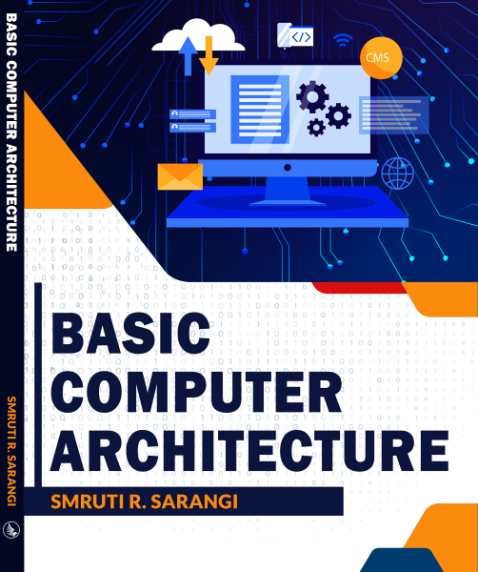


2nd version
www.basiccomparch.com
Download the pdf of the book
videos
Slides, software, solution manual
The pdf version of the book and all the learning resources can be freely downloaded from the website: www.basiccomparch.com
Print version
(Publisher: WhiteFalcon, 2021)
Available on e-commerce sites.

Slide 3
What is Computer Architecture ?
Answer : It is the study of computers ?
Computer Architecture
The view of a computer as presented to software designers
Computer Organization
The actual implementation of a computer in hardware.
3

Slide 4


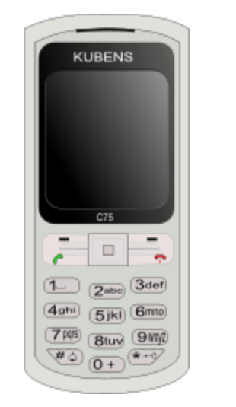
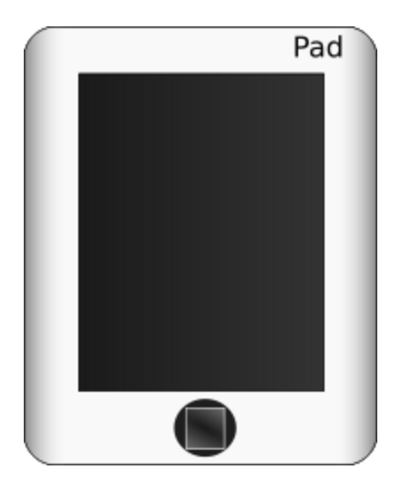
What is a Computer ?
A computer is a general purpose device that can be programmed to process
information, and yield meaningful results.
4

Slide 5
How does it work ?
Information
store
Program
Computer
results
Program – List of instructions given to the computer
Information store – data, images, files, videos
Computer – Process the information store according to the instructions in the program
5

Slide 6
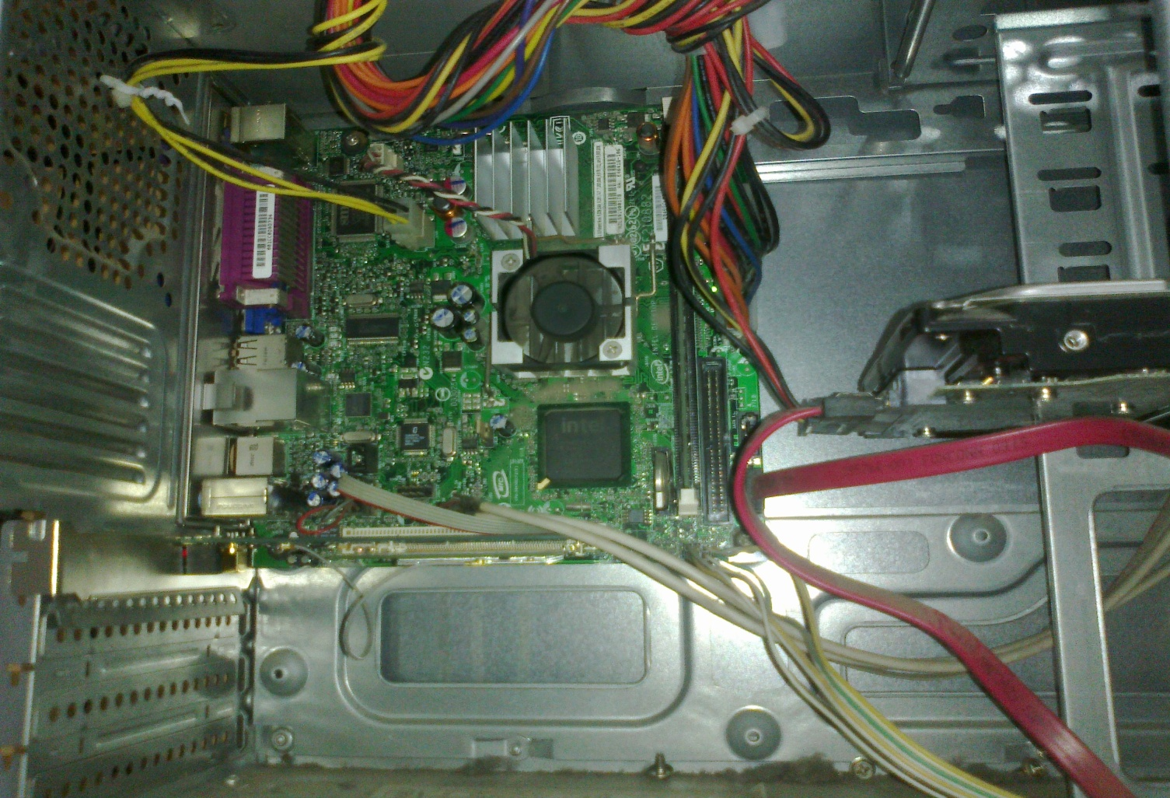
What does a computer look like ?
Let us take the lid off a desktop computer
CPU
Hard disk
Memory
6

Slide 7
Memory
Hard disk
Computer
Memory – Stores programs and data. Gets destroyed when the computer is powered off
Hard disk – stores programs/data permanently
7

Slide 8
Let us make it a full system ...
Memory
Hard disk
Computer
Keyboard
Monitor
Mouse
Printer
8

Slide 9

Food for Thought...
What is the most intelligent computer ?
9

Slide 10
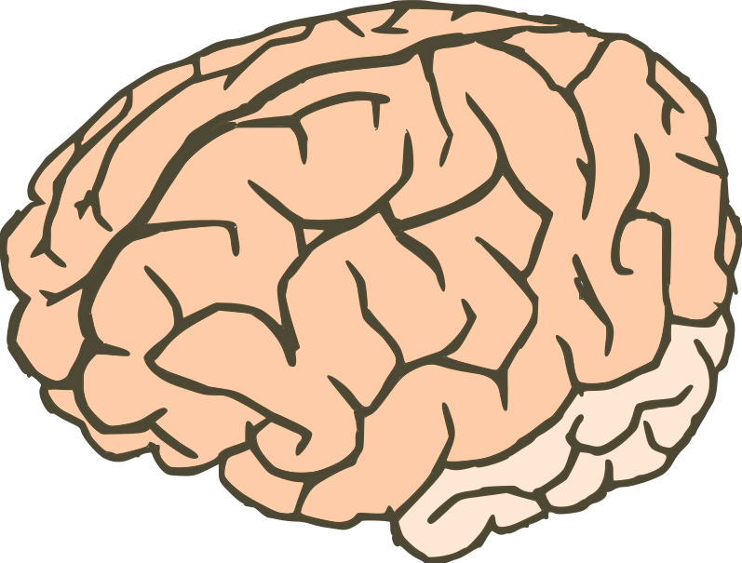
Answer ...
Our brilliant brains
10

Slide 11
Outline
Language of Instructions
Instruction Set Architecture
Features of an ISA – Complete, Concise, Generic, Simple
Completeness of an ISA
Turing Machines
Universal Machines
Single Instruction/Multi-Instruction ISA
Design of Practical Machines
Harvard/ Von Neumann Machines
Registers
Road Ahead
11

Slide 12
How does an Electronic Computer Differ from our Brain ?
Feature
Computer
Our Brilliant Brain
Intelligence
Dumb
Intelligent
Speed of basic calculations
Ultra-fast
Slow
Can get tired
Never
After sometime
Can get bored
Never
Almost always
Computers are ultra-fast and ultra-dumb
12

Slide 13
How to Instruct a Computer ?
compile
execute
Program
Executable
Output
Write a program in a high level language – C, C++, Java
Compile it into a format that the computer understands
Execute the program
13

Slide 14
What Can a Computer Understand ?
Computer can clearly NOT understand instructions of the form
Multiply two matrices
Compute the determinant of a matrix
Find the shortest path between Mumbai and Delhi
They understand :
Add a + b to get c
Multiply a * b to get c
14

Slide 15
The Language of Instructions
Humans can understand
Complicated sentences
English, French, Spanish
Computers can understand
Very simple instructions
The semantics of all the instructions supported by a processor is known
as its instruction set architecture (ISA). This includes the semantics of
the instructions themselves, along with their operands, and interfaces
with peripheral devices.
15

Slide 16
Features of an ISA
Example of instructions in an ISA
Arithmetic instructions : add, sub, mul, div
Logical instructions : and, or, not
Data transfer/movement instructions
Complete
It should be able to implement all the programs that users may write.
16

Slide 17
Features of an ISA – II
Concise
The instruction set should have a limited size. Typically an ISA contains 32-1000 instructions.
Generic
Instructions should not be too specialized, e.g. add14 (adds a number with 14) instruction is too specialized
Simple
Should not be very complicated.
17

Slide 18
Designing an ISA
Important questions that need to be answered :
How many instructions should we have ?
What should they do ?
How complicated should they be ?
Two different paradigms : RISC and CISC
RISC
(Reduced Instruction Set
Computer)
CISC
(Complex Instruction
Set Computer)
18

Slide 19
RISC vs CISC
A reduced instruction set computer (RISC) implements
simple instructions that have a simple and regular
structure. The number of instructions is typically a small
number (64 to 128). Examples: ARM, IBM PowerPC,
HP PA-RISC
A complex instruction set computer (CISC) implements complex instructions that are highly irregular, take multiple operands, and implement complex functionalities. Secondly, the number of instructions is large (typically
500+). Examples: Intel x86, VAX
19

Slide 20
Summary Uptil Now ...
Computers are dumb yet ultra-fast machines.
Instructions are basic rudimentary commands used to communicate with the processor. A computer can execute billions of instructions per second.
The compiler transforms a user program written in a high level language such as C to a program consisting of basic machine instructions.
The instruction set architecture(ISA) refers to the semantics of all the instructions supported by a processor.
The instruction set needs to be complete. It is desirable if it is also concise, generic, and simple.
20

Slide 21
Outline
Language of Instructions
Instruction Set Architecture
Features of an ISA – Complete, Concise, Generic, Simple
Completeness of an ISA
Turing Machines
Universal Machines
Single Instruction/Multi-Instruction ISA
Design of Practical Machines
Harvard/ Von Neumann Machines
Registers
Road Ahead
21

Slide 22


Completeness of an ISA
How can we ensure that an
ISA is complete ?
Complete means :
Can implement all types of programs
For example, if we just have add instructions, we cannot subtract (NOT Complete)
22

Slide 23
Completeness of an ISA – II
How to ensure that we have just enough instructions such that we can implement every possible program that we might want to write ?
Skip this part
23

Slide 24
Answer
Let us look at results in theoretical computer science
Is there an universal ISA ?
Universal ISA
Universal Machine
The universal machine has a set of basic actions, and each such
action can be interpreted as an instruction.
24

Slide 25
The Turing Machine – Alan Turing
Facts about Alan Turing
Known as the father of computer science
Discovered the Turing machine that is the most powerful computing device known to man
Indian connection : His father worked with the Indian Civil Service at the time he was born. He was posted in Chhatrapur, Odisha.
25

Slide 26
Turing Machine
Infinite Tape
L
R
State Register
Tape Head
The tape head can only move left or right
Action Table
(old state, old symbol) -> (new state, new symbol, left/right)
26

Slide 27
Operation of a Turing Machine
There is an inifinite tape that extends to the left and right. It consists of an infinite number of cells.
The tape head points to a cell, and can either move 1 cell to the left or right
Based on the symbol in the cell, and its current state, the Turing machine computes the transition :
Computes the next state
Overwrites the symbol in the cell (or keeps it the same)
Moves to the left or right by 1 cell
The action table records the rules for the transitions.
27

Slide 28
Example of a Turing Machine
Design a Turing machine to increment a number by 1.
$
7
3 4 6 9
$
Tape Head
Start from the rightmost position. (state = 1)
If (state = 1), replace a number x, by x+1 mod 10
The new state is equal to the value of the carry
Keep going left till the '$' sign
28

Slide 29
More about the Turing Machine
This machine is extremely simple, and extremely powerful
We can solve all kinds of problems – mathematical problems, engineering analyses, protein folding, computer games, …
Try to use the Turing machine to solve many more types of problems (TODO)
29

Slide 30
Church-Turing Thesis
Church-Turing thesis: Any real-world computation can be translated
into an equivalent computation involving a Turing machine.
(source: Wolfram Mathworld)
Note : It is a thesis, not a theorem
For the last 60 years, nobody has found a counter-example
Definition:
Any computing system that is equivalent to a Turing machine is said to be
Turing complete.
30

Slide 31
Universal Turing Machine
For every problem in the world, we can design a Turing Machine (Church-Turing thesis)
Can we design a universal Turing machine that can simulate any Turing machine. This will make it a universal machine (UTM)
Why not? The logic of a Turing machine is really simple. We need to move the tape head left, or right, and update the symbol and state based on the action table. A UTM can easily do this.
A UTM needs to have an action table, state register, and tape that can simulate any arbitrary Turing machine.
31

Slide 32
Universal Turing Machine
Prog. 1
Prog. 2
Prog. 3
Turing Machine 1
Turing Machine 2
Turing Machine 3
Universal Turing Machine
32

Slide 33
A Universal Turing Machine
Simulated State Register
Simulated Action Table
Work Area
L
R
Generic State Register
Tape Head
Generic Action Table
33

Slide 34
A Universal Turing Machine - II
Program Counter
(PC)
Instruction Memory
Simulated State Register
Data Memory
Simulated Action Table
Work Area
L
R
Generic State Register
Tape Head
CPU
Program
PC
Generic Action Table

Slide 35
Computer Inspired from the Turing Machine
Program
CPU
Program
Control
Arithmetic
Counter (PC)
Unit
Unit
Instruction
Program
Data
Memory
35

Slide 36
Elements of a Computer
Memory (array of bytes) contains
The program, which is a sequence of instructions
The program data → variables, and constants
The program counter(PC) points to an instruction in a program
After executing an instruction, it points to the next instruction by default
A branch instruction makes the PC point to another instruction (not in sequence)
CPU (Central Processing Unit) contains the
Program counter, instruction execution units
36

Slide 37
Let us now design an ISA ...
Single Instruction ISA
sbn – subtract and branch if negative
Add (a + b) (assume temp = 0)
1: sbn temp, b, 2
2: sbn a, temp, exit
37

Slide 38
Single Instruction ISA - II
Add the numbers – 1 … 10
Initialization:
one = 1
index = 10
sum = 0
1: sbn temp, temp, 2 // temp = 0
2: sbn temp, index, 3 // temp = -1 * index
3: sbn sum, temp, 4 // sum += index
4: sbn index, one, exit // index -= 1
5: sbn temp, temp, 6 // temp = 0
6: sbn temp, one, 1 // (0 - 1 < 0), hence goto 1
exit
38

Slide 39
Multiple Instruction ISA
Arithmetic Instructions
add, subtract, multiply, divide
Logical Instructions
or, and, not
Move instructions
Transfer values between memory locations
Branch instructions
Move to a new program location, based on the values of some memory locations
39

Slide 40
Outline
Language of Instructions
Instruction Set Architecture
Features of an ISA – Complete, Concise, Generic, Simple
Completeness of an ISA
Turing Machines
Universal Machines
Single Instruction/Multi-Instruction ISA
Design of Practical Machines
Harvard/ Von Neumann Machines
Registers
Road Ahead
40

Slide 41
Designing Practical Machines
CPU
ALU
Data
Instruction
Control
memory
memory
I/O devices
Harvard Architecture
41

Slide 42
Von-Neumann Architecture
CPU
ALU
Memory
Control
I/O devices
42

Slide 43


Problems with Harvard/ Von-Neumann Architectures
The memory is assumed to be one large array of bytes
It is very very slow
Solution:
Have a small array of named locations (registers) that can be used by instructions
This small array is very fast
General Rule: Larger is a structure, slower it is
Insight: Accesses exhibit locality (tend to use the same
variables frequently in the same window of time)
43

Slide 44
Uses of Registers
A CPU (Processor) contains set of registers (16-64)
These are named storage locations.
Typically values are loaded from memory to registers.
Arithmetic/logical instructions use registers as input operands
Finally, data is stored back into their memory locations.
44

Slide 45
Example of a Program in Machine Language with Registers
1: r1 = mem[b] // load b
2: r2 = mem[c] // load c
3: r3 = r1 + r2 // add b and c
4: mem[a] = r3 // save the result
r1, r2, and r3, are registers
mem → array of bytes representing memory
45

Slide 46
Machine with Registers
CPU
Registers
ALU
Memory
Control
I/O devices
46

Slide 47
Outline
Language of Instructions
Instruction Set Architecture
Features of an ISA – Complete, Concise, Generic, Simple
Completeness of an ISA
Turing Machines
Universal Machines
Single Instruction/Multi-Instruction ISA
Design of Practical Machines
Harvard/ Von Neumann Machines
Registers
Road Ahead
47

Slide 48


Where are we ...
We have derived the structure of a computer from theoretical fundamentals.
It has a CPU with a program counter & registers, memory, and peripherals.
The Instruction Set Architecture (ISA) is the link between hardware and software.
Instruction
Set
Architecture
48

Slide 49
Instruction Set Architecture
Interface between software and hardware
A compiler converts a program into machine instructions in the given ISA
The processor executes the instructions in the ISA
We shall first look at the software aspect of the ISA (assembly programs)
Then look at implementing the ISA by designing the processor
Then, we shall make the computer more efficient by designing fast memory/ storage systems
At the end, we will look at multiprocessors
49

Slide 50
Roadmap of the Course
Software interface
Processor Design
System design
8
9
10
Memory
4
ARM assembly
Processor
Pipelining
system
2
3
design
11
Language
Assembly
6
7
Multiprocessors
of bits
language
Building blocks:
Computer
Instruction set architecture
gates, registers,
arithmetic
12
I/O and storage
5
and memories
Design of a simple processor
x86 assembly
Software
Hardware
Hardware
engineer
designer
designer
50

Slide 51
THE END
51

